Slide 1
Intelligent QA SYSTEM
Submitted by
Harsha PRUDHVI SADANAND NIKITHA

Slide 2
What is nlp???
NLP is a way for computers to analyze, understand, and derive meaning from human language in a smart and useful way
NLP is a way for computers to analyze, understand, and derive meaning from human language in a smart and useful way.
By utilizing NLP, developers can organize and structure knowledge to perform tasks such as automatic summarization, translation, named entity recognition, relationship extraction, sentiment analysis, speech recognition, and topic segmentation.

Slide 3
NLP AppLICATIONS
Machine Translation
Fighting Spam
Information Extraction
Summarization
Question Answering

Slide 4
QA System
Question answering (QA) in information retrieval, is the task of automatically answering a question posed in natural language (NL) using either a pre-structured database or a (local or online) collection of natural language documents
Who is Obama?
When was Obama born?
What is the full name of Obama?
Where was Obama born?

Slide 5
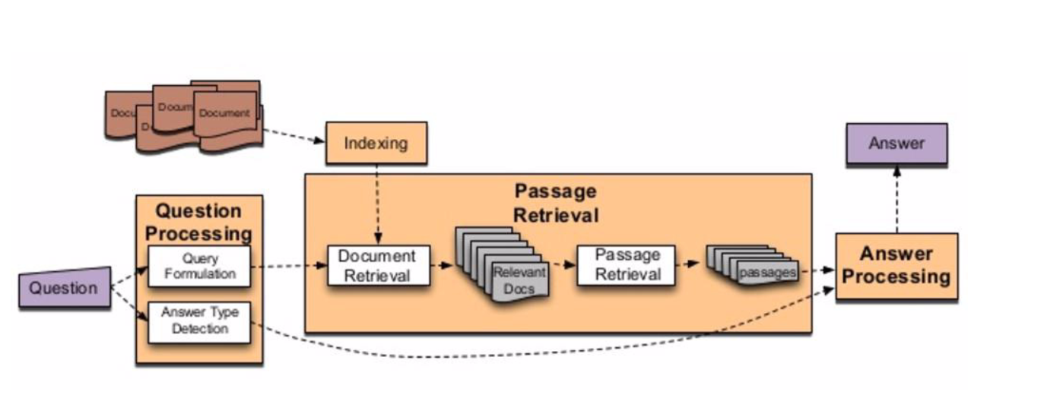
Traditional IR System

Slide 6
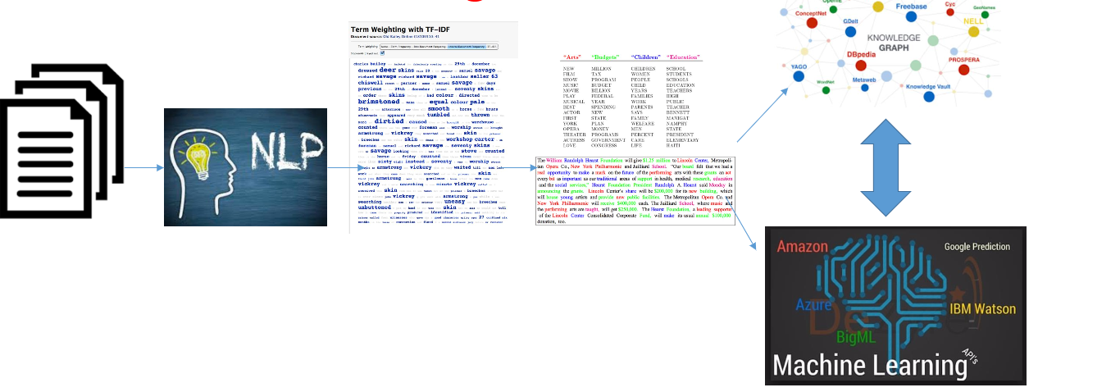
Text to knowledge graph

Slide 7
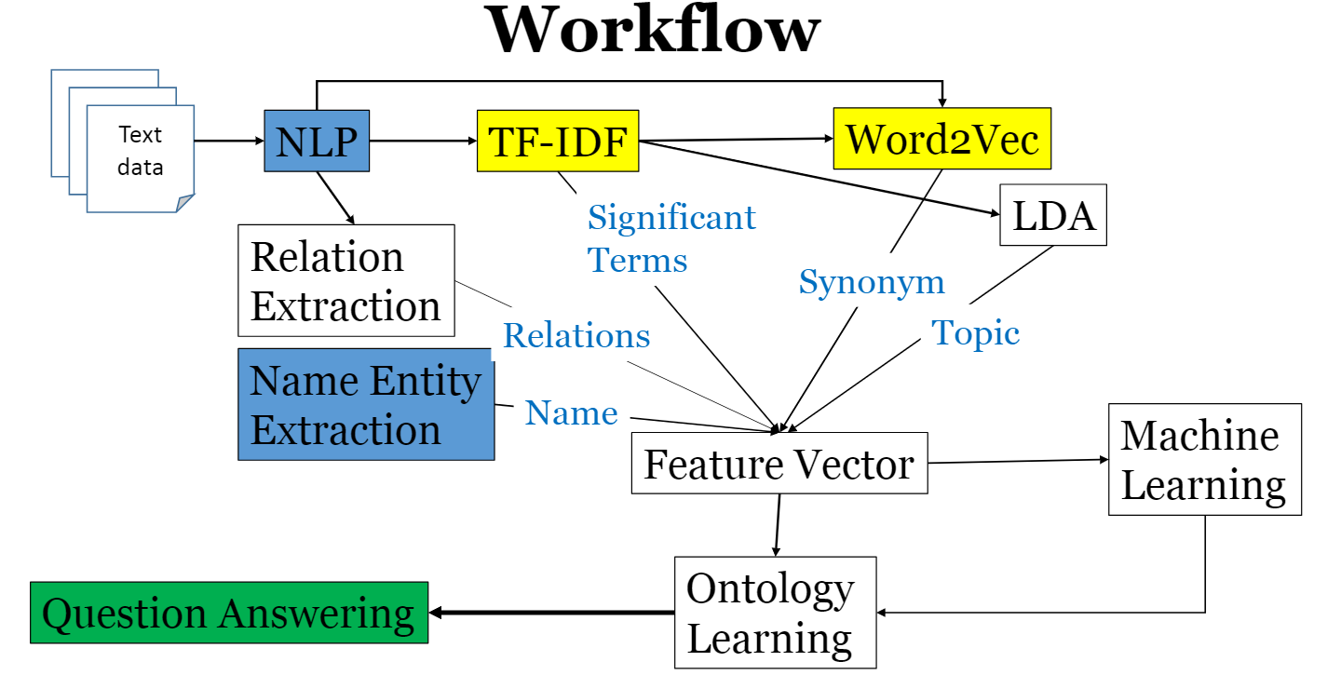
Workflow

Slide 8
Question-1&2
When did this Incident take place?
Who are the main characters in the dataset?
ddss
NER
Dataset
NLP
Answer
POS

Slide 9
Question 3
What is the full name of Obama?
Ngram on dataset& split&check for NER(1,2,3,4)
Answer
Question
NLP
(NER)

Slide 10
Question 4,7
What are the trending topics in the Dataset?
What is the Synonym of the Word?
Data
TFIDF
Wordnet
Trending words
Synonyms

Slide 11
Question 3,5,8
Who is the President of United States?
When was Obama born?
Tell me about Obama?
Question
Stopword removal
NLP operation
Openie to extract SPO
Answer

Slide 12
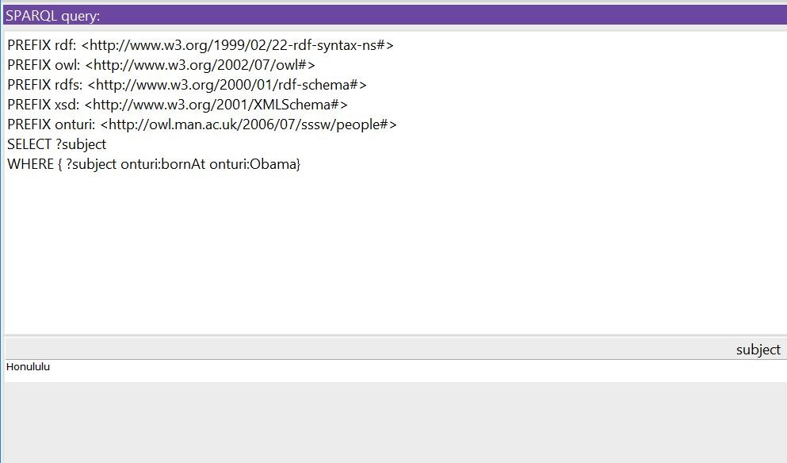
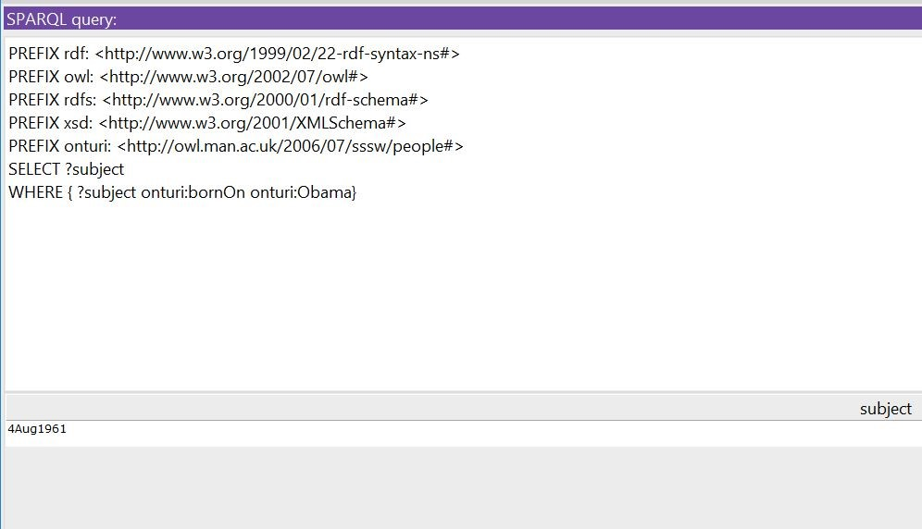
SPARQL QUERIES

Slide 13
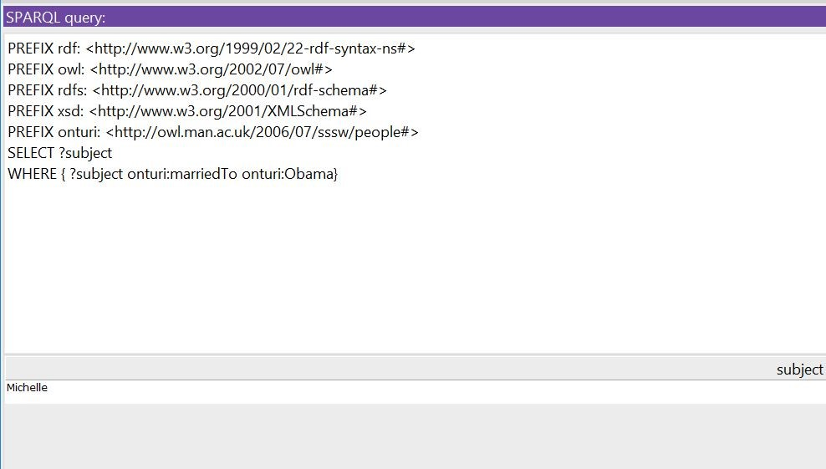
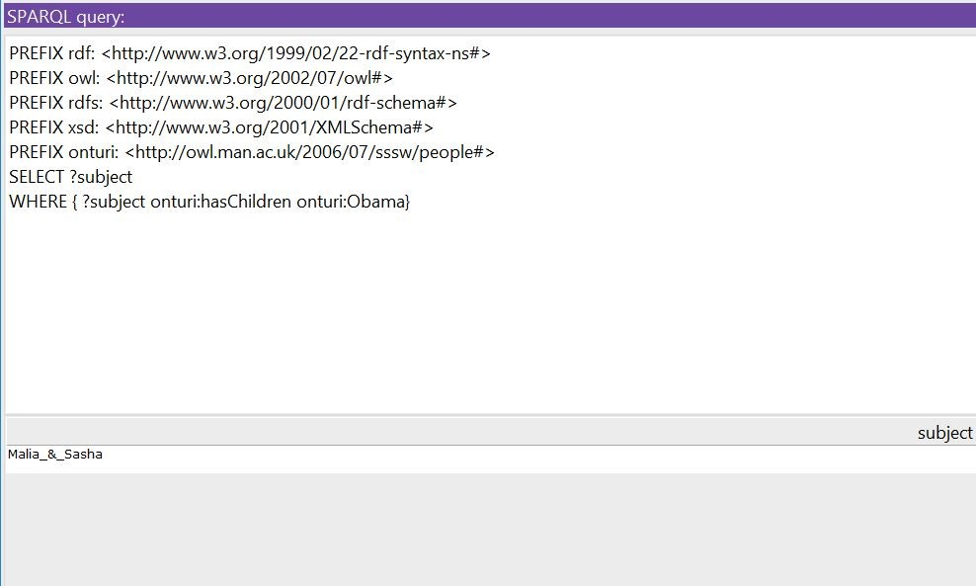
SPARQL QUERIES

Slide 14
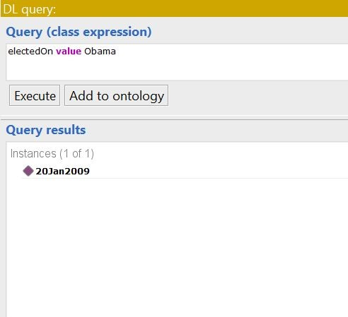
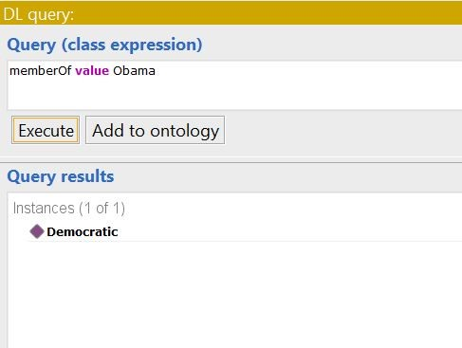
DL QUERIES

Slide 15
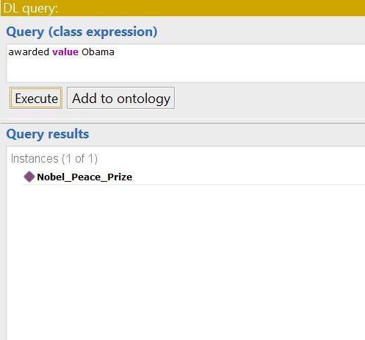
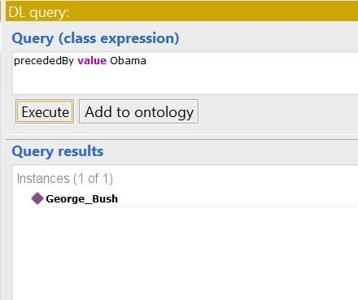
DL QUERIES

Slide 16
Video
https://www.youtube.com/watch?v=_0WqclRRJDA&feature=youtu.be

